Slide 1
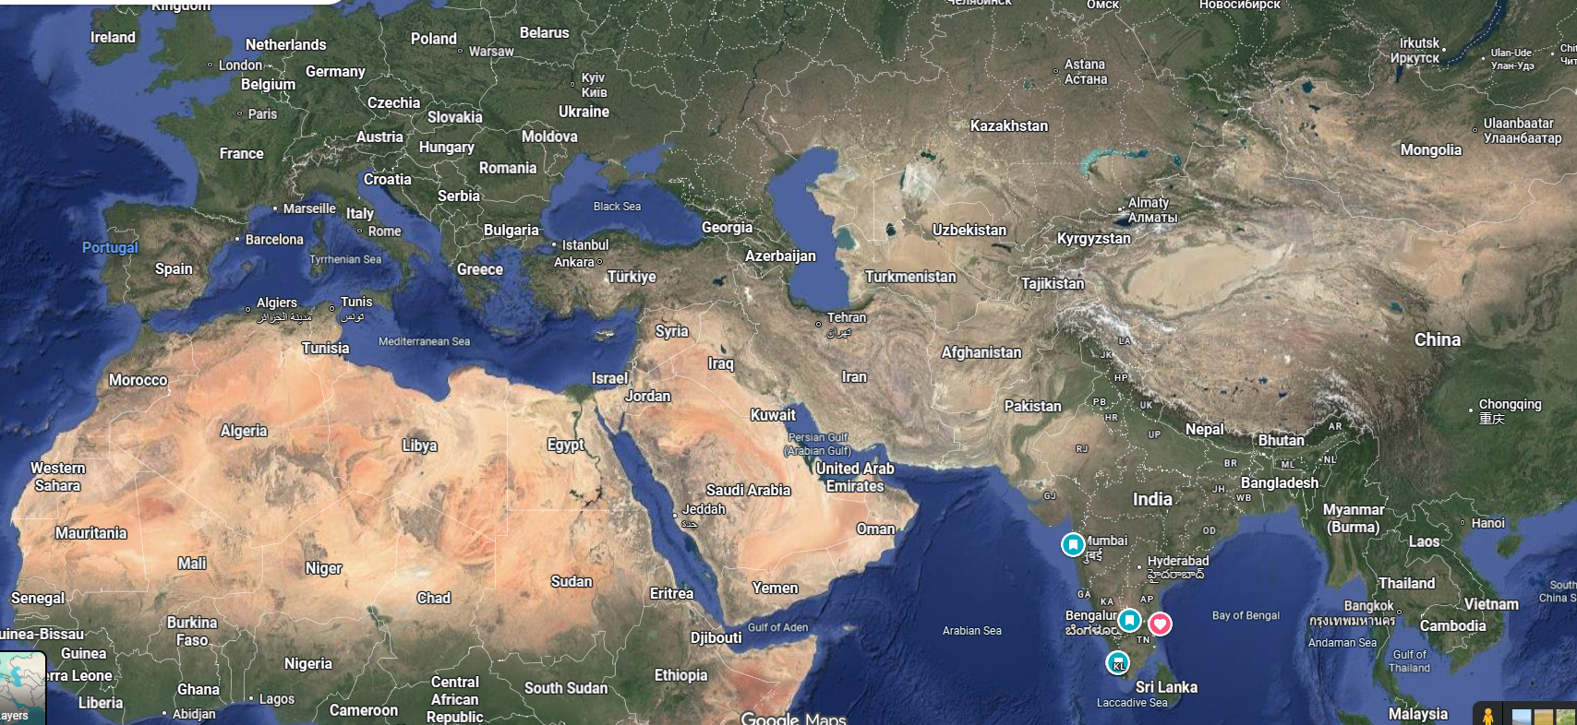

Slide 3
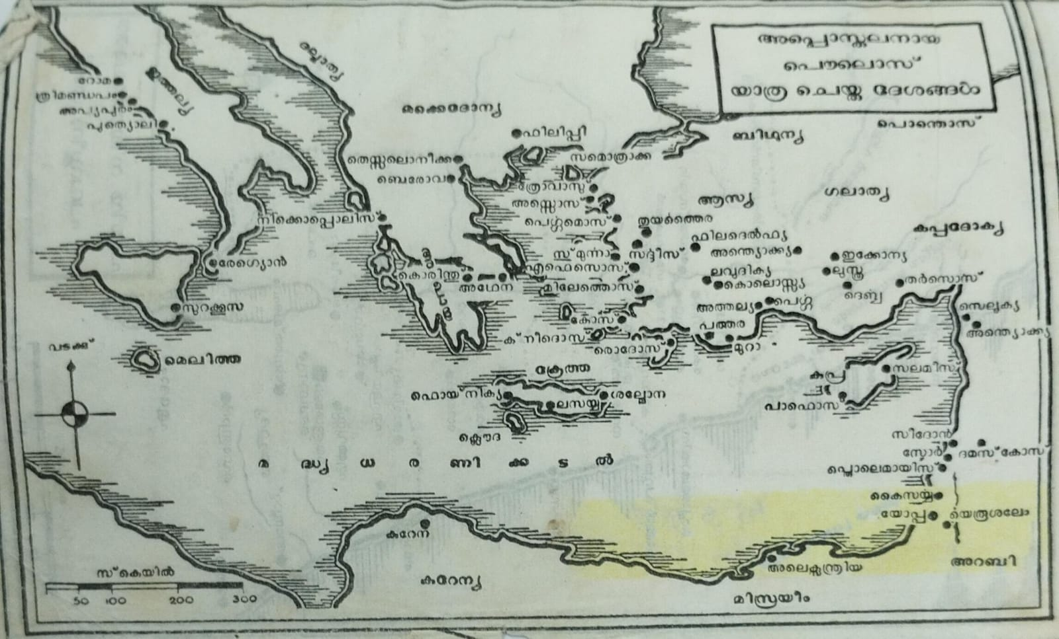

Slide 6
PAULINE 1st MISSIONARY JOURNEY
ANTIOCH - SYRIA
SELEUCIA - SYRIA
SALAMIS - CYPRUS
PAPHOS - CYPRUS
PERGA – PAMPHYLIA
ANTIOCH – PYSIDYA, CAPITAL OF GALATIA
ICCONIA
LYSTRA
DERBE

Slide 7
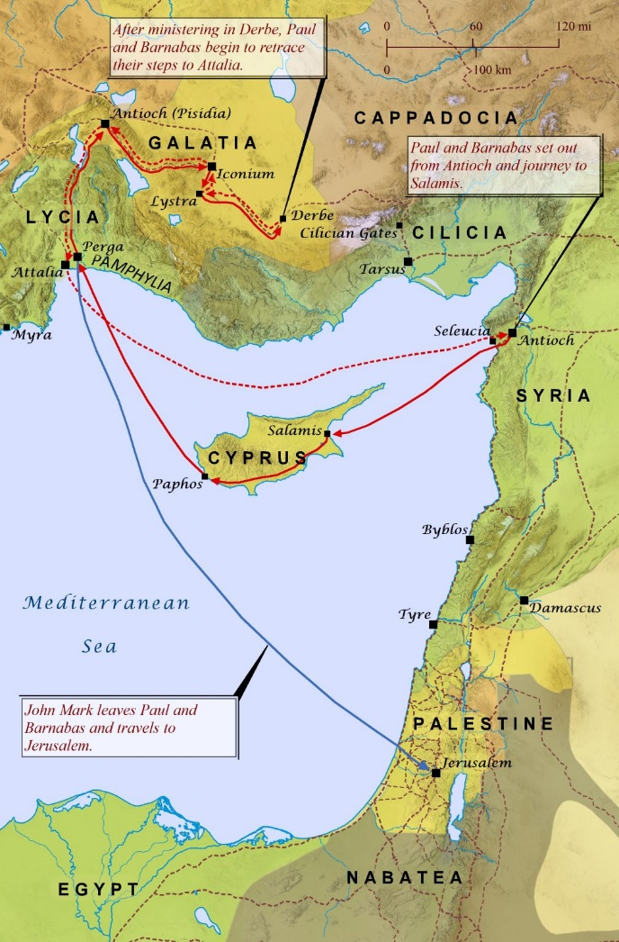

Slide 8
